Slide 1
ECON 1259 Development Economics
Lecture 7:
Human Capital: Health and Education in Economic Development

Slide 2
Learning objectives
Understand the role of health and education in development
Identify the returns to education
Understand the concept of child labour
Recognise the gender gap in human capital
Scrutinise education and health systems in developing countries
Identify policies to promote health and education

Slide 3
8.1 The Central Roles of Education and Health
Health and education are important objectives of development, as reflected in Amartya Sen’s capability approach, and in the core values of economic development
Health and education are also important components of growth and development

Slide 4
Education and Health as Joint Investments for Development
Greater health capital may improve the returns to investments in education
  Health is a factor in school attendance
  Healthier students learn more effectively
  A longer life raises the rate of return to education
  Healthier people have lower depreciation of education capital
Greater education capital may improve the returns to investments in health
  Public health programs need knowledge learned in school
  Basic hygiene and sanitation may be taught in school
  Education needed in training of health personnel

Slide 5
Improving Health and Education: Increasing Incomes Is Not Sufficient
Increases in income often do not lead to substantial increases in investment in children’s education and health
But better educated mothers tend to have healthier children at any income level
Significant market failures in education and health require policy action

Slide 6
8.2 Investing in Education and Health: The Human Capital Approach
Initial investments in health or education lead to a stream of higher future income
The present discounted value of this stream of future income is compared to the costs of the investment
Private returns to education are high,
However, private returns may be higher than social returns, particularly at higher educational levels, when accounting for education subsidies

Slide 7
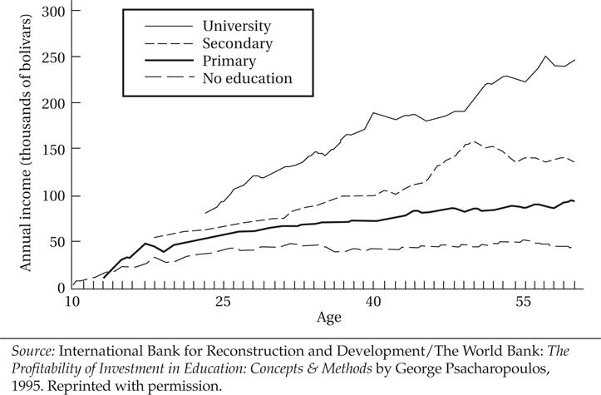
Figure 8.1 Age-Earnings Profiles by Level of Education: Venezuela

Slide 8
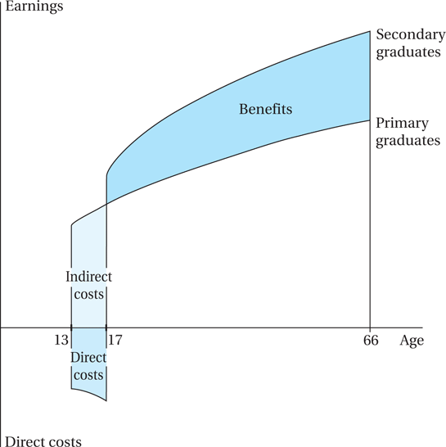
Figure 8.2 Financial Trade-Offs in the Decision to Continue in School

Slide 9
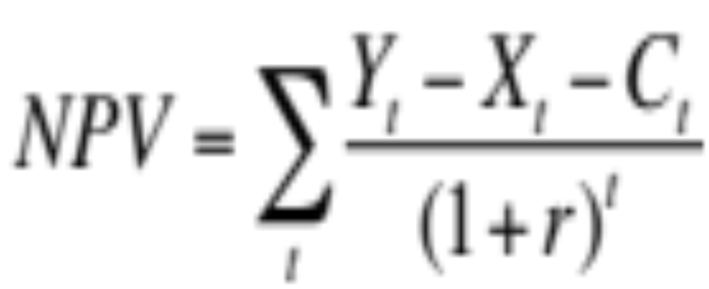
Algebraic version of the schooling decision diagram
Net Present Value (NPV) of the income stream is given by:
Where:
t is time (year) from present. (The present is time t = 0.)
Y_{t} is expected income from having gone to school, realized at time t
X_{t} is expected income from having NOT gone to school, at time t
C_{t} is the cost of going to school borne at time t (if any)
r is the rate of discount used

Slide 10
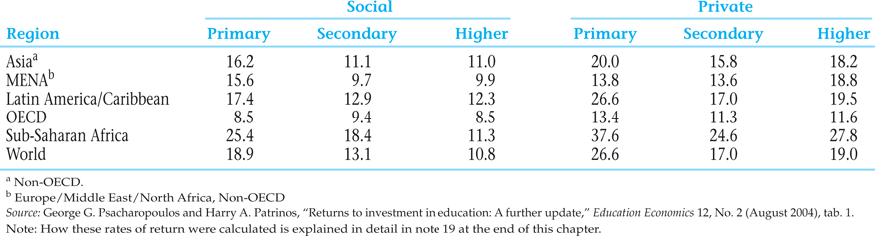
Table 8.1 Returns to Investment in Education by Level, Regional Averages (%)

Slide 11
8.3 Child Labor
The world pledged to end child labour by 2025
Despite progress, child labour still affects nearly 138 (7.8%) million children worldwide (UNICEF, 2025)
There are 54.0 million Children in hazardous work (3.1%)
Caused by poverty – wages very low
A ban on child labour will help by raising the wage
Adults will receive the higher wage and are less likely to send their children out to work

Slide 12
Other approaches to child labor policy
Help get more children into school (as in Sustainable Development Goals), e.g. building new village schools; and providing enrollment incentives for parents (such as in Progresa/ Oportunidades)
Consider child labor an expression of poverty, so emphasize ending poverty generally, rather than child labor directly (a traditional World Bank approach, now modified)
If child labor is inevitable in the short run, regulate it to protect children, and to provide support services for working children (“UNICEF approach”)
Ban child labor; or if impossible, ban child labor in its most abusive forms (ILO approach; “Worst Forms of Child Labor Convention”)
Activist approach: trade sanctions
  Concerns: Sanctions could backfire when the result is that children shift to informal sector; and if modern sector growth slows

Slide 13
8.4 The Gender Gap: Discrimination in Education and Health
Young females receive less education than young males in nearly every low and lower-middle income developing country
Closing the educational gender gap is important because:
  The social rate of return on women’s education is higher than that of men in developing countries
  Education for women increases productivity, lowers fertility
  Educated mothers have a multiplier impact on future generations
  Education can break the vicious cycle of poverty and inadequate schooling for women
  Good news: Parity being approached, progress in every developing region

Slide 14
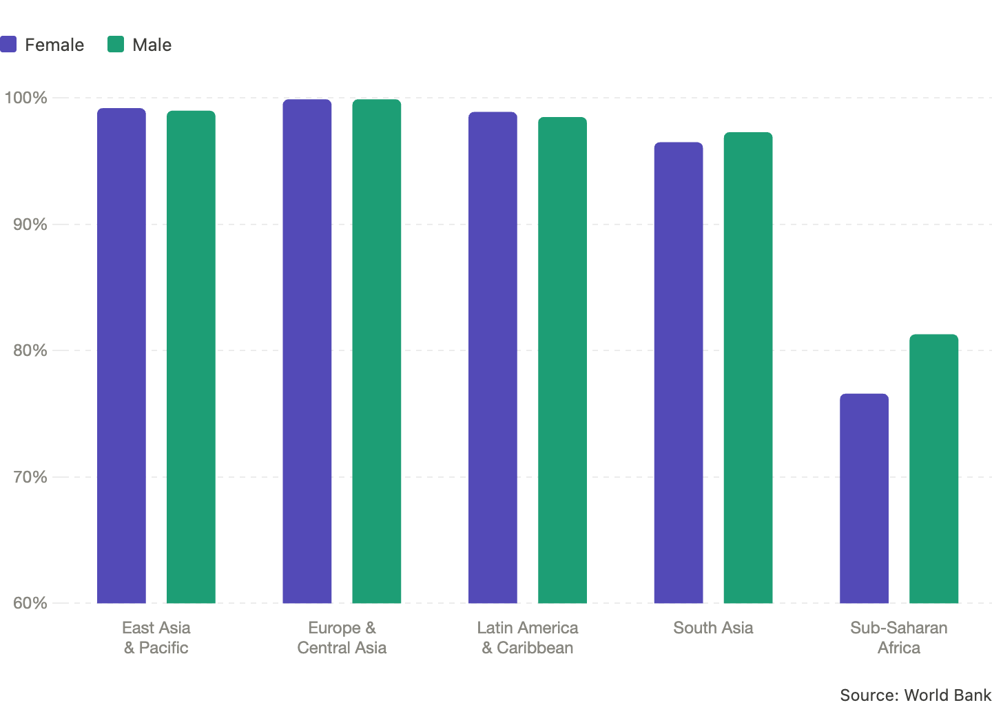
Youth literacy rates (18-24), 2024

Slide 15
8.4 The Gender Gap: Discrimination in Education and Health (cont’d)
Consequences of gender bias in health and education
  Economic incentives and their cultural setting
  “Missing Women” mystery in Asia
  Increases in family income does not always lead to better health and education

Slide 16
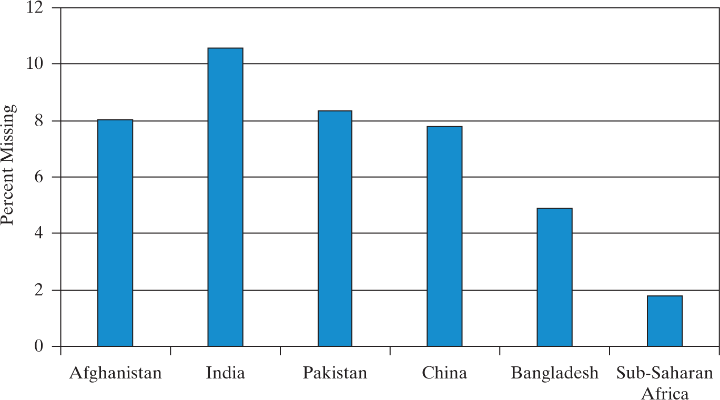
Figure 8.6
Estimated Percentage of Women “Missing”
Source: United Nations, Department of Economic and Social Affairs, Population Division (2017)

Slide 17
The “Missing Women” Crisis
Research has concluded that in Asia at least 100 million women are “missing”…
  Update: Bongaarts and Guilmoto 2015: 126 million missing globally; numbers still rising, projected to reach 150m by 2035
…If gender ratios were closer to normal levels based on biology, comparing regions such as Europe, North America and Latin America
  That is a minimum number of additional women who would be alive in Asia
Some women are also missing in Africa, but a much smaller proportion
Reasons include inferior medical care for girls (postnatal factors), and gender selective abortion (prenatal selection) or even female infanticide

Slide 18
8.5 Educational Systems and Development
Educational supply and demand
Social versus private benefits and costs
Distribution of education
Education, inequality, and poverty
Education, Internal Migration, and the Brain Drain

Slide 19
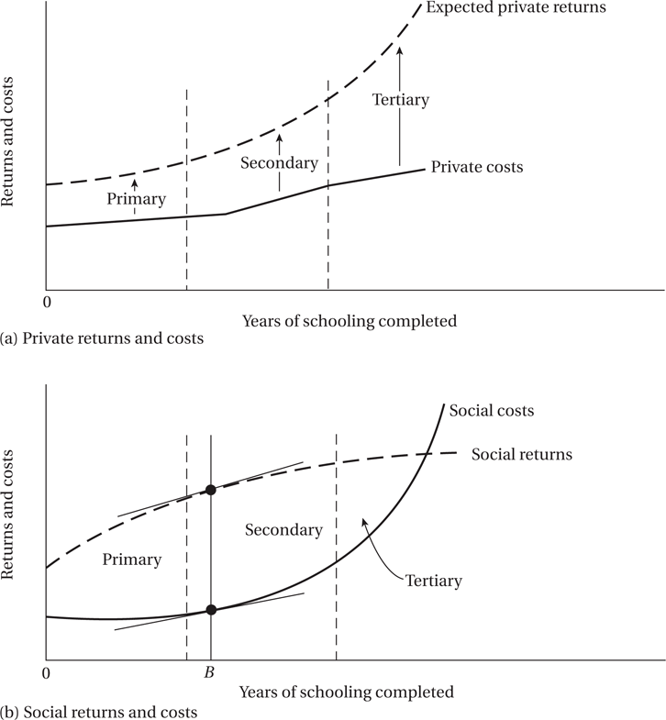
Figure 8.6 Private versus Social Benefits and Costs of Education: An Illustration

Slide 20
8.5 Educational Systems and Development (cont’d)
Distribution of Education
  Lorenz curves for the distribution of education
Education, Inequality, and Poverty

Slide 21
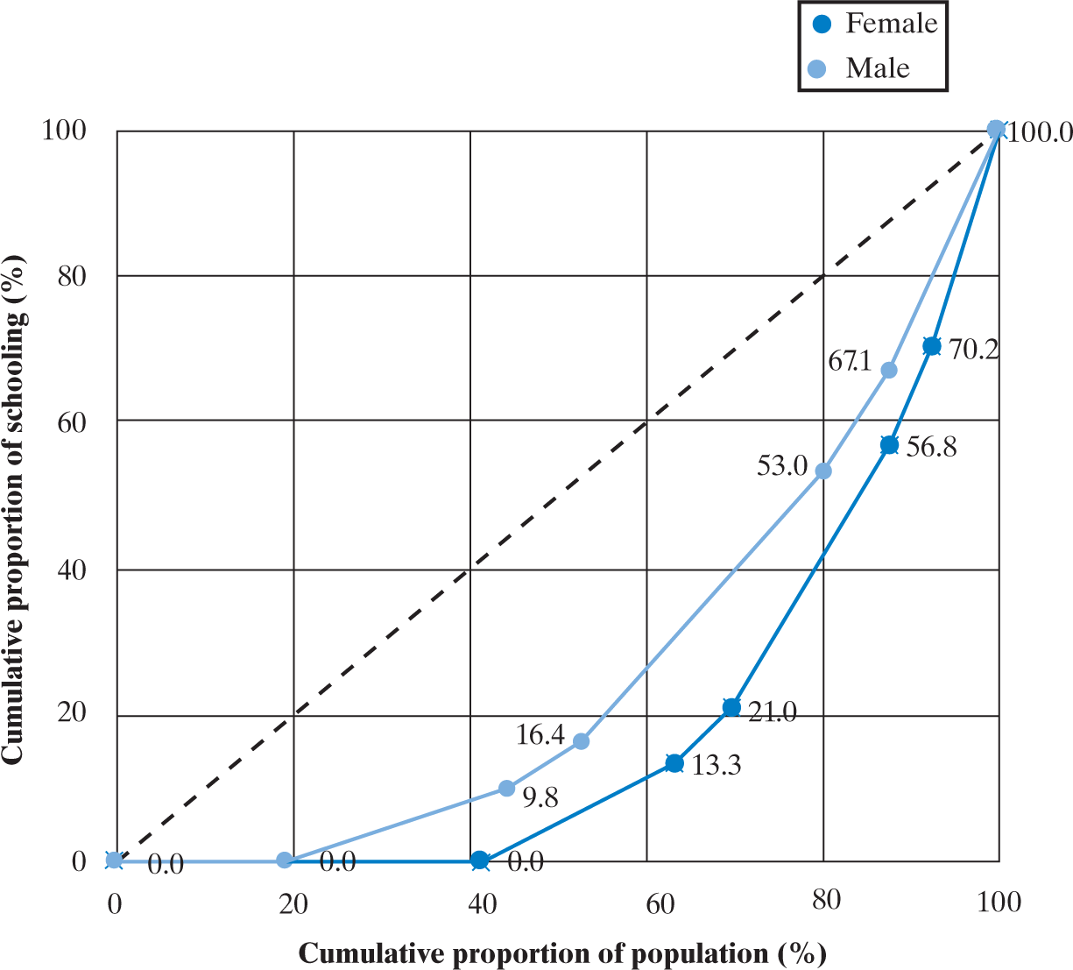
Figure 8.7
Lorenz Curves for Education in India
Source: https://www.epdc.org/epdc-data-points/epdc-spotlight-india; Data are based on the 2006 DHS India household dataset.

